Slide 1

Fostering 21st‑Century Literacies in K–12 Classrooms
By William Fonda
CSU Global
OTL 545
Tyler Watts

Slide 2
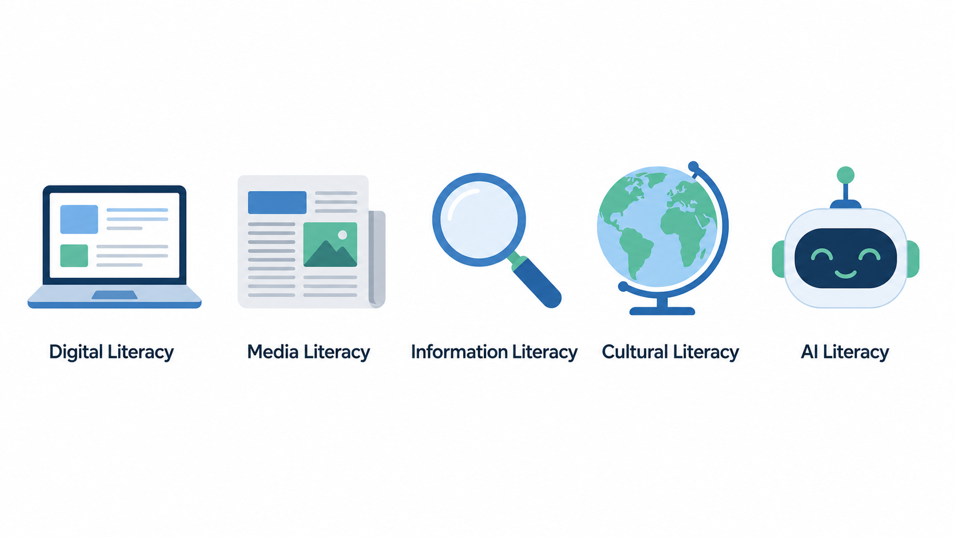

Why 21st‑Century Literacies Matter
21st‑century skills go beyond content; they include communication, collaboration, critical thinking, creativity, and adaptability needed for college, career, and civic life.
Integrating literacies into daily instruction helps close the gap between school tasks and the skills demanded in a technology‑driven, post‑pandemic workforce.
Literacies are not “extras”; they are the way students access, evaluate, create, and share knowledge in every subject area.
Why These Literacies Are Essential:
The Future
Success in Life
Adapting to Technology
Relevance to the evolving modern world

Slide 3

Digital Literacy
Why it matters:
Students learn, work, and socialize in digital spaces; they need to navigate platforms, protect privacy, and manage their digital footprint to be successful and safe.
Classroom example:
Middle school students use a learning management system (e.g., Google Classroom) to submit assignments, give peer feedback using comments, and manage deadlines, explicitly teaching file naming, password hygiene, and online etiquette.
Tech integration strategy:
Mini “how‑to” routines:
  Weekly 5‑minute “Tech Move of the Week” (e.g., organizing files in cloud folders, using accessibility tools like read‑aloud or translation).
  Students reflect on how the tool helped their learning in a quick exit ticket.
Definition:
The ability to use digital tools, platforms, and devices effectively, safely, and ethically to access, create, and share information.

Slide 4
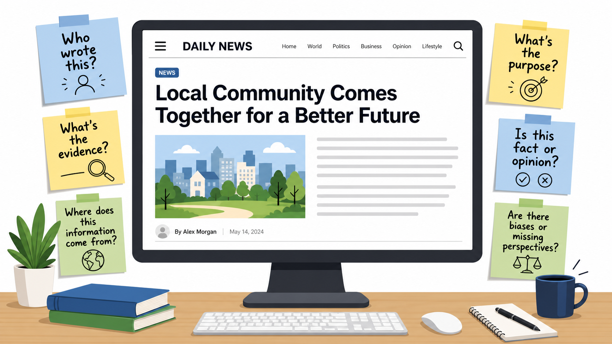
Media Literacy
Definition:
The ability to analyze, evaluate, and create messages in a wide range of media formats, recognizing bias, purpose, and credibility.
Why it matters:
Students encounter constant streams of news, ads, and social content; media literacy helps them distinguish fact from opinion, identify misinformation, and understand persuasive techniques.
Classroom example:
Students compare two news articles and a social media post about the same event, identifying audience, purpose, and techniques (headline framing, images, emotional language).
Tech integration strategy:
Use tools like screenshot annotation, Padlet/Jamboard, or shared slides for students to mark up media artifacts (where is the claim? what evidence is used? what is missing?).
Have students create short public‑service announcements or infographics to practice ethical message creation.

Slide 5
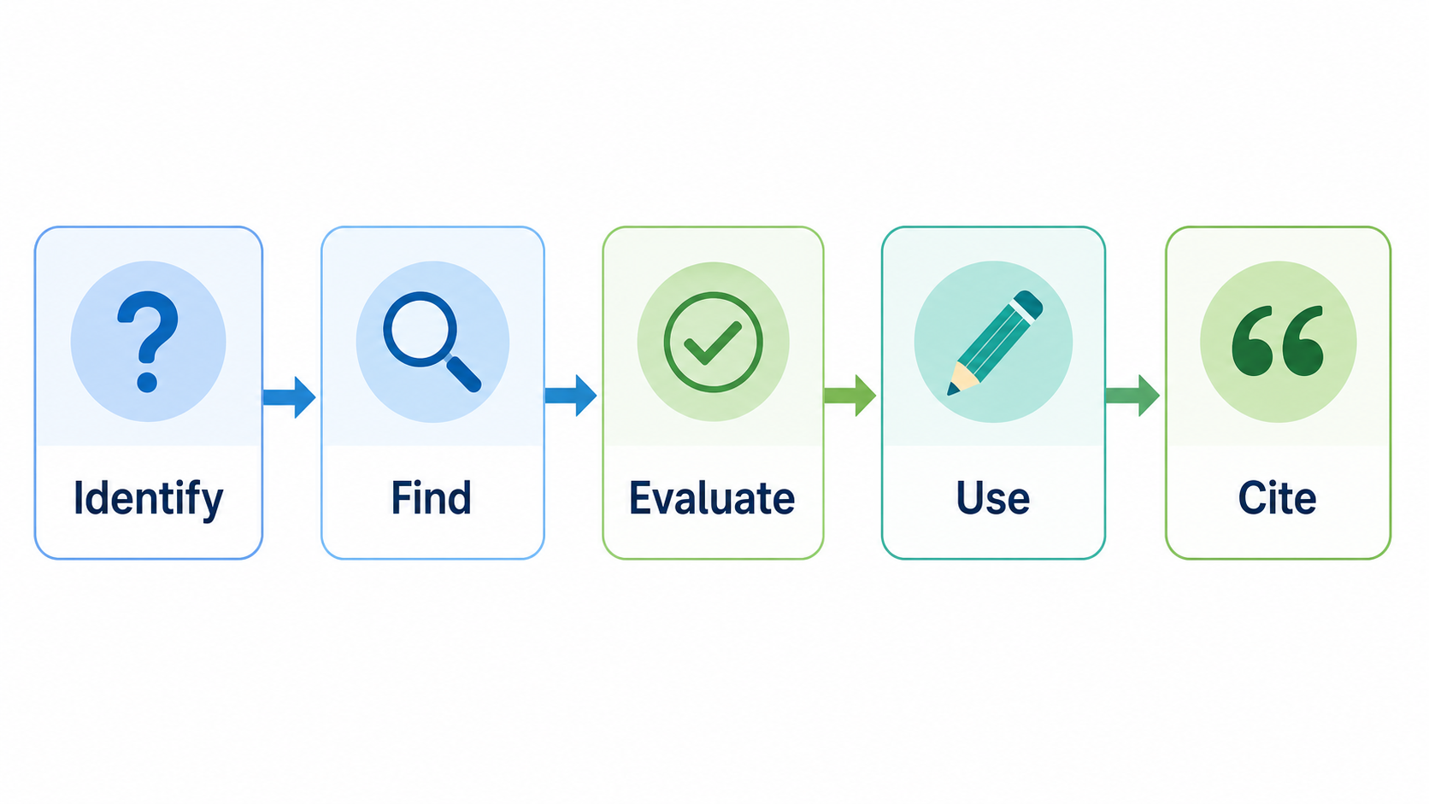
Information Literacy
Definition:
The ability to locate, evaluate, and use information effectively and ethically, including understanding search strategies, source credibility, and citation.
Why it matters:
In an information‑rich environment, students must learn to ask good questions, vet sources, and synthesize information rather than copy‑paste.
Classroom example:
During an inquiry project, students generate research questions, identify keywords, compare a peer‑reviewed article, a news site, and a commercial site, and decide which is most appropriate for their purpose.
Tech integration strategy:
Teach structured search (keywords, quotation marks, filters) and use digital note‑taking tools (e.g., OneNote, Google Docs) to track sources and paraphrases.
Integrate citation tools (e.g., citation managers, built‑in “cite” features in databases) and require a simple reference list even in middle school.

Slide 6

Cultural Literacy
Definition:
The ability to understand, respect, and interact across diverse cultures, perspectives, and identities, recognizing how culture shapes communication and knowledge.
Why it matters:
Classrooms and workplaces are increasingly global and diverse; cultural literacy supports empathy, reduces bias, and builds inclusive collaboration skills.
Classroom example:
Students work in diverse teams to investigate how a global issue (e.g., access to clean water, public health, climate change) is experienced in different communities, using voices from multiple countries and cultural backgrounds.
Tech integration strategy:
Use video conferencing tools, virtual exchanges, or moderated discussion boards to connect with classrooms elsewhere.
Curate digital texts, videos, and primary sources representing varied cultures and languages, and have students reflect on whose voices are present or missing.

Slide 7

AI Literacy
Definition :
The ability to understand what AI tools are and are not, how they use data, and how to use them ethically, critically, and creatively in learning and work.
Why it matters:
AI now shapes search results, recommendations, and productivity tools; students need to understand limitations (bias, hallucinations, privacy) and possibilities (drafting, feedback, data analysis) to be future‑ready.
Classroom example:
High school students compare AI‑generated summaries with original sources, noting inaccuracies and omissions, then revise the AI output and discuss when AI assistance is and is not appropriate.
Tech integration strategy:
Establish clear classroom guidelines for AI use (e.g., allowed for brainstorming, not for final answers; always cite use).
Use AI tools as “thinking partners” (idea generation, question prompts, practice problems) while requiring students to show their own reasoning and reflection.

Slide 8
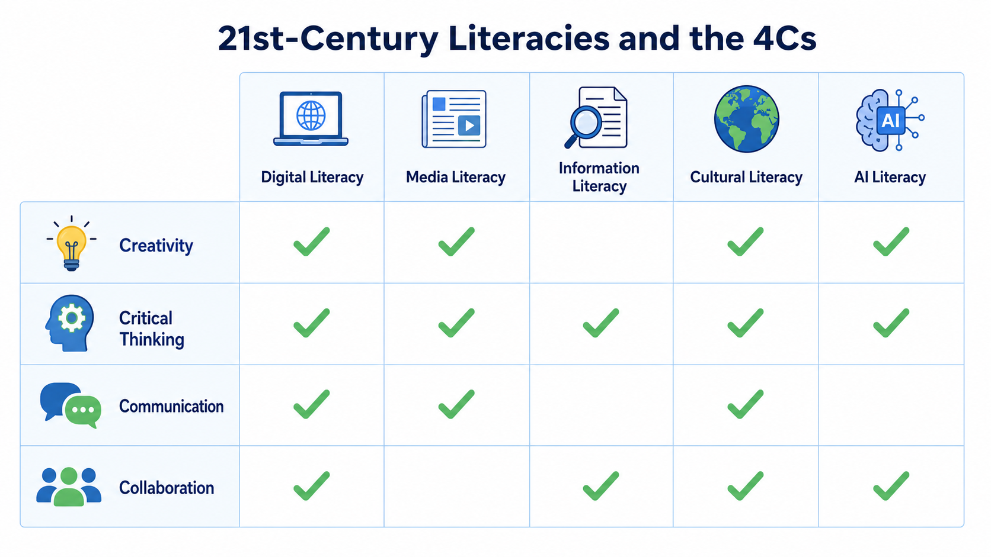
Connecting Literacies to the 4Cs
Key points :
Digital, media, information, cultural, and AI literacies are vehicles for developing creativity, critical thinking, communication, and collaboration.
Project‑based and inquiry‑based learning that integrate these literacies better prepare students for the “future of work” and lifelong learning.
Assessment should capture both individual performance and the extent to which the school environment systematically supports these skills.

Slide 9

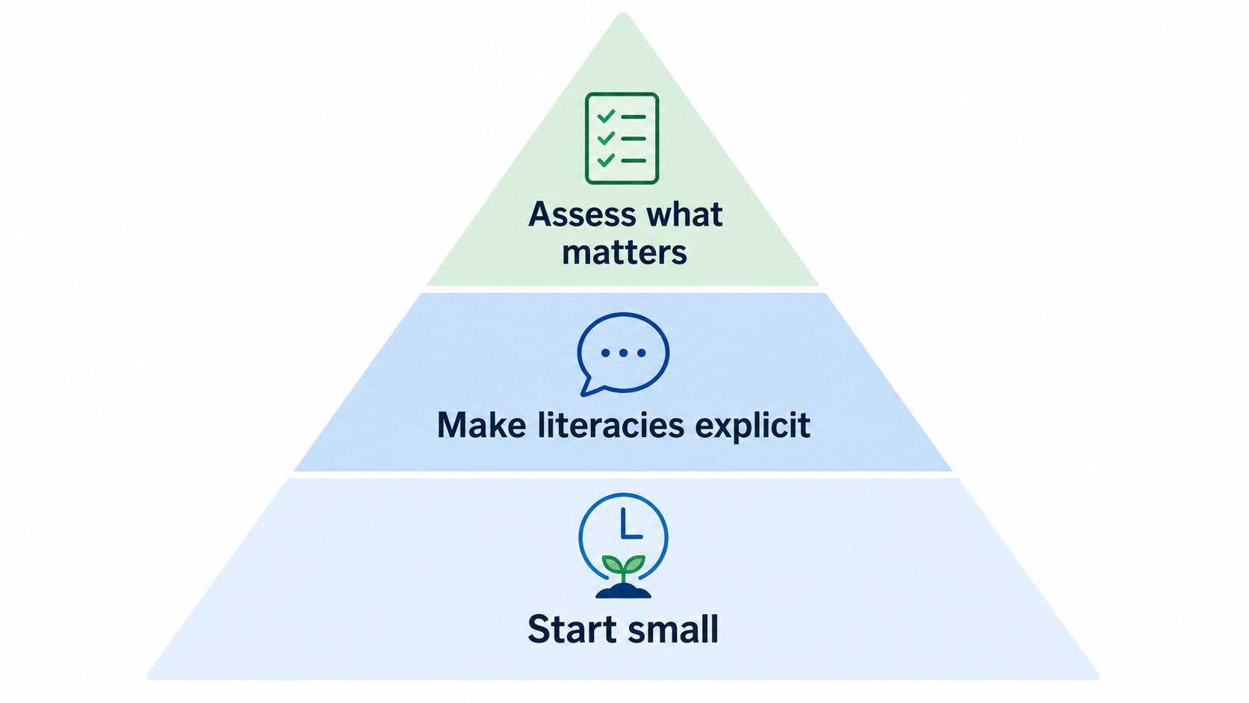
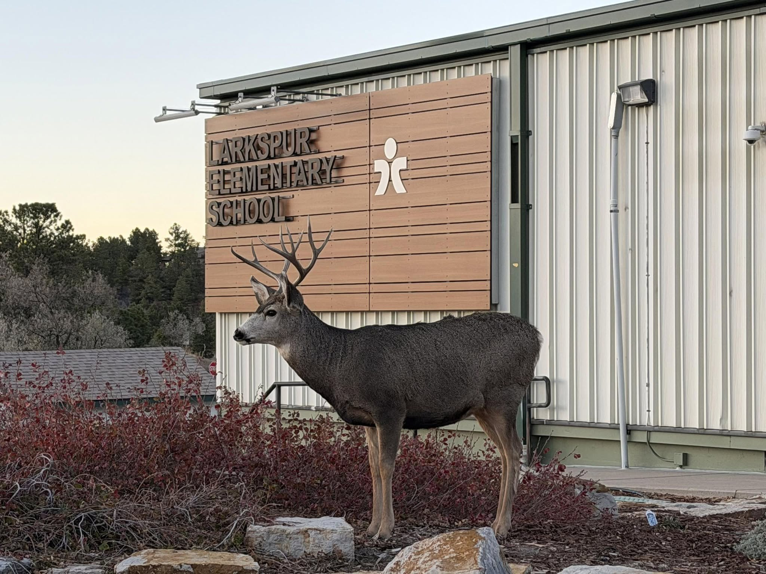
Practical Takeaways for Educators
Start small: choose one literacy and embed a 10–15 minute routine (e.g., weekly source‑credibility check or media‑annotation mini‑task).
Make literacies explicit: share learning targets (e.g., “Today we are practicing information literacy by evaluating sources, not just finishing our slides.”).
Assess what matters: use rubrics that foreground collaboration, critical reasoning about information, and ethical technology use, not only content recall.
Action Steps for Your Classroom

Slide 10
References
Panorama Education. (n.d.). A comprehensive guide to 21st‑century skills. Panorama Education. https://www.panoramaed.com/blog/comprehensive-guide-21st-century-skills
Shouman, D., Itani, A., & Kawtharani, A. (2023). Preparing Students with Twenty First Century Skills for the Future Post-Pandemic Era. In Reimagining Education - The Role of E-Learning, Creativity, and Technology in the Post-Pandemic Era. IntechOpen. https://doi.org/10.5772/intechopen.1001993
Thornhill‑Miller, B., & Camarda, A. (2023). Creativity, critical thinking, communication, and collaboration: Assessment, certification, and promotion of 21st‑century skills for the future of work and education. Journal of Intelligence, 11(2), Article 35. https://doi.org/10.3390/jintelligence11020035

